Slide 1

FLY SHARE
Siddharth Kumar - 1145​2
Tharun Balisetty - 114​62
Abhishek Polamarasetty - 114​78
Sravya Pothuraju - 11485
Presented By

Slide 2

FLY SHARE
FlyShare is a travel platform that makes it easy for people to share luggage while traveling. It uses technology to help passengers connect and share their luggage securely. With a user-friendly app, FlyShare aims to simplify how people manage their baggage, making travel more convenient and affordable.

Slide 3
Introduction
Software Design Document:
This software design document presents a detailed overview of the architectural design, system functionalities, and components integral to the FlyShare platform. It encompasses a comprehensive analysis of the system architecture, database structure, and component-level designs, providing a blueprint for the successful implementation and deployment of the FlyShare application.
Test Plan Document:
The Test Plan describe the overall testing strategy and plan to validate the functionality, performance, and security of the "FlyShare" web application before public launch.

Slide 4
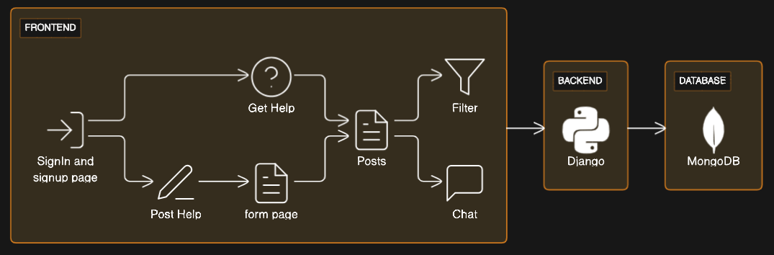
System Architecture

Slide 5
Database design
User Profiles:
Collection: Users
Field : Username, Email, Password, First_name,Last_name,
Posts & filter:
Collection: Posts
Field: User_id, Passenger name, Departure date,
Departure city, Destination City, Flight Number, PNR number, Baggage description
Chat:
Collection: Chat
Field: Sender_id, Receiver_id, Message, timestamp, Image

Slide 6
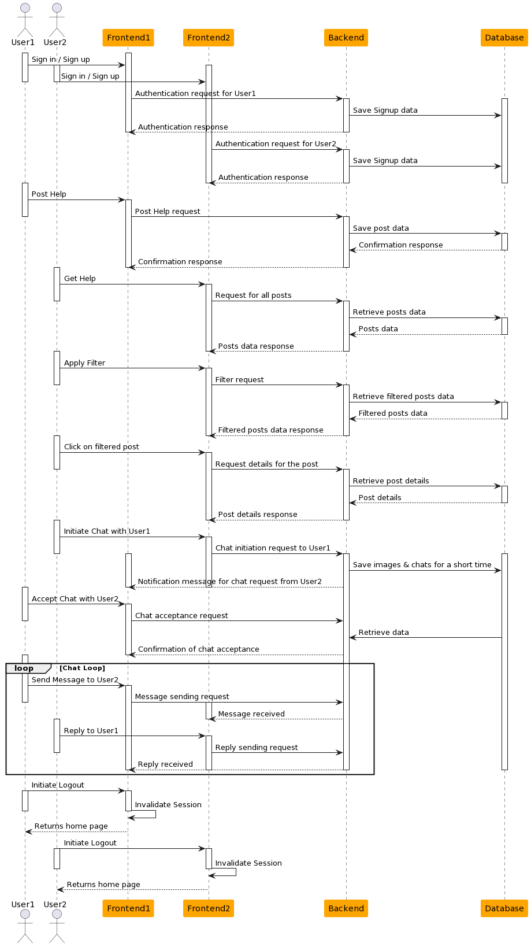
SEQUENCE DIAGRAM
It depicts the flow of messages, actions, and their chronological sequence, showcasing how various entities collaborate and communicate to accomplish a specific task or functionality.
Sequence diagrams employ lifelines (vertical lines representing objects or participants) and messages (horizontal arrows indicating communication between lifelines) to demonstrate the chronological order and flow of interactions among these objects

Slide 7
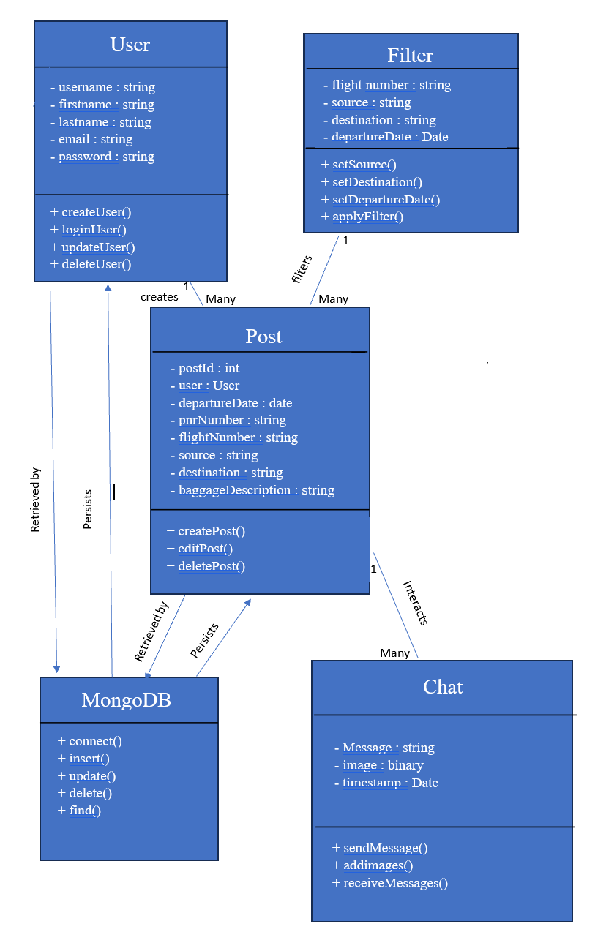
CLASS DIAGRAM
A class diagram is a visual representation used in software engineering to illustrate the structure of a system by showing classes, their attributes, methods, and relationships between classes.
Classes represent entities in the system, while attributes define their properties or characteristics, and methods depict their behaviors or functions.

Slide 8
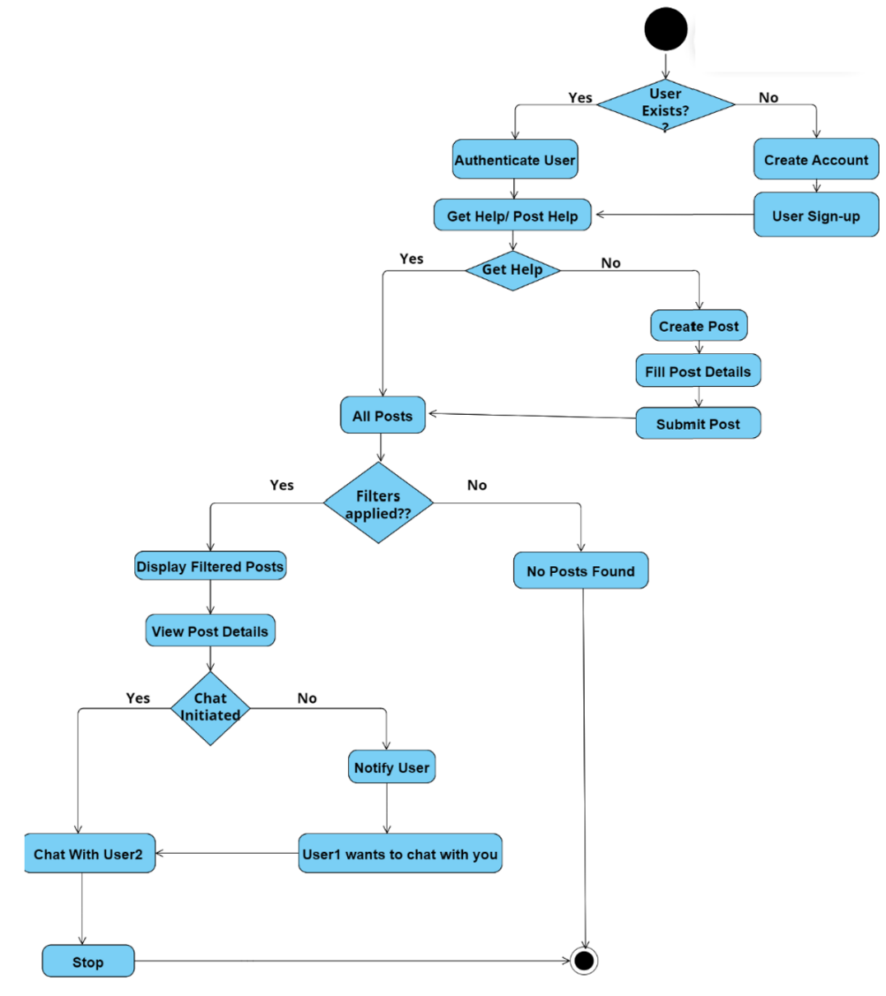
ACTIVITY DIAGRAM
It portrays the flow of activities or actions within a system, showcasing the sequence of tasks, decisions, and transitions from one activity to another.
Activity diagrams use various elements such as nodes (representing activities or actions), transitions (connecting these activities), decision points, and control flows to illustrate the flow of control or logic within the system.

Slide 9
Unit Testing Plan
Unit testing involves the testing of each unit or an individual component of the software application. It is the first level of functional testing. The aim behind unit testing is to validate unit components with its performance.
Units Identified for Testing:
User Authentication
Create help Post
Filter posts
Chat Module
Alerts & Notifications
Review System
Sl. No | Test ID | Test Description | Input | Expected Output | Actual Output | Test Result (Pass/ Fail)
1 | SI_001 | Valid Credentials | Registered email & password | Sign in successful, dashboard page loads
2 | SI_002 | Invalid Credentials | Invalid Credentials | Invalid Credentials

Slide 10
Integration Test Plan
Methodology Used:
The integration testing will follow the
Bottom-up methodology.
As FlyShare have numerous smaller components in the user, post, and communication modules,starting from lower-level modules could ensure the foundational elements function correctly before moving to the higher-level interactions.
Approach -
Component Identification
Start with Foundational Modules
Incremental Integration
Regression Testing

Slide 11
System Testing/ User Acceptance Test
Testing Methodology:
The testing methodologies for system testing and user acceptance testing are as follows:
System Testing: Comprehensive testing of the entire application, covering all functionalities and use cases.
User Acceptance Testing (UAT): End-users will validate the application against their requirements and expectations.

Slide 12
THANK YOU

